Slide 1

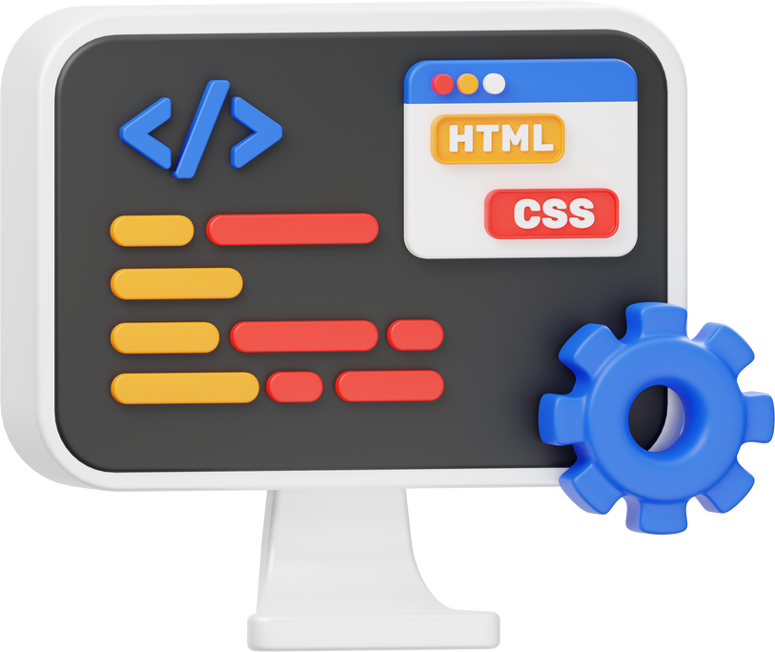
Introduction to object-oriented programming (oop)

Slide 2

Evolution of Oop
Pre-OOP Era (1950s-1970s)
Procedural Language (Fortran)
Structural Language (C)
Early Concepts Leading to OOP:
Simula (1967): First to introduce classes, objects, inheritance, and polymorphism.
Formalization and Wider Adoption (1980s):
Inclusion of oop concepts in C and the rise of C++.
Modern Era (2000s-Present):
Agile works on oop principles.
Functional programming.
Mainstream Adoption (1990s):
Sun Microsystem builts Java.
Microsoft builts C#.

Slide 3

Encapsulation
Abstraction
Restricts access to an object's state using private attributes and public methods.
Hides implementation details using abstract methods and classes.
OOP
PRINCIPLES
Inheritance
Polymorphism
Inherits properties and methods from a parent class, allowing method overriding
Uses the same method name across different classes but
with different implementations.

Slide 4
Platform Independent
Multithreading
Java
OOP Language
FEATURES
Robust
Garbage Collection
Secure

Slide 5
Input statements
Output statements
Scanner Class
System.out.print()
< import java.util.Scanner >
System.out.println()
Buffer reader class
System.out.printf()

Slide 6
Command line arguments
Input
public class CommandLineExample {
public static void main(String[] args) {
// Checking if arguments are passed
if (args.length > 0) {
System.out.println("Command Line Arguments: ");
for (String arg : args) {
System.out.println(arg);
}
} else {
System.out.println("No arguments passed.");
}
}
}
java CommandLineExample Hello World 123
Output
Command Line Arguments:
Hello
World
123

Slide 7







Primitive Data Types in Java
B
byte (1)
F
float (4)
S
short (2)
D
double (8)
I
int (4)
C
char
L
long (8)
B
boolean

Slide 8
Reference Data Types in Java
C
Class
I
Interface
A
Array
S
String

Slide 9

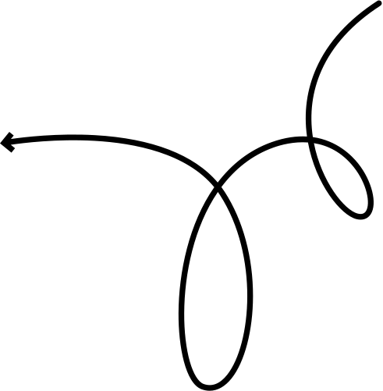
Array
An array in Java is a collection of elements identified by an index or a key.
Example:
public class SingleDimensionalArray {
public static void main(String[] args) {
// Declare and initialize a single-dimensional array
int[] numbers = {1, 2, 3, 4, 5};
// Access and print elements of the array
for (int i = 0; i < numbers.length; i++) {
System.out.println(numbers[i]);
}
}
}
Array Declaration
int[] arr; // Preferred style
int arr[]; // Valid but not preferred
Array Initialization
int[] arr = {10, 20, 30}; // Static
int[] arr = new int[5]; // Dynamic

Slide 10
String
In Java, strings are objects that represent sequences of characters.
String Characteristics
String creation using String Literal
Immutable: Once a string is created, it cannot be changed. Any operation that modifies a string will result in a new string being created.
Reference Type: Strings are reference types in Java, meaning they store references to objects rather than the actual string data.
String str1 = "Hello, World!";
String str2 = "Hello, World!";
String creation using new Keyword
String str1 = new String("Hello, World!");
String str2 = new String("Hello, World!");

Slide 11
Operations on Strings
length(): Returns the length of the string.
charAt(index): Returns the character at the specified index.
substring(start): Returns a substring from the given starting index.
equals(String): Compares two strings for equality.
substring(start, end): Returns a substring between the specified start and end indices.
replace(old, new): Replaces occurrences of old with new in the string.
contains(substring): Checks if the string contains the specified substring.

Slide 12

Thank You for Listening!

